Slide 1


Heart Disease Diagnostic Analysis

Slide 2
Content
Problem statement
Feature description
Main KPIs
Python analysis
Inferences from python analysis
Dashboarding(using Tableau)
Insights
Conclusion

Slide 3

Problem Statement
Health is real wealth in the pandemic time we all realized the brute effects of covid-19 on all irrespective of any status. You are required to analyze this health and medical data for better future preparation.
Perform EDA through python.
Make the necessary dashboard with the best you can extract from the data.
Find key metrics and factors and show the meaningful relationships between attributes.

Slide 4
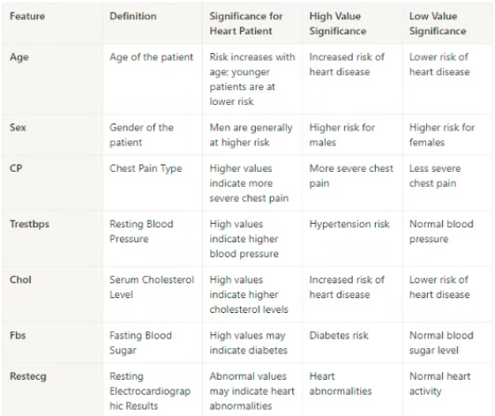
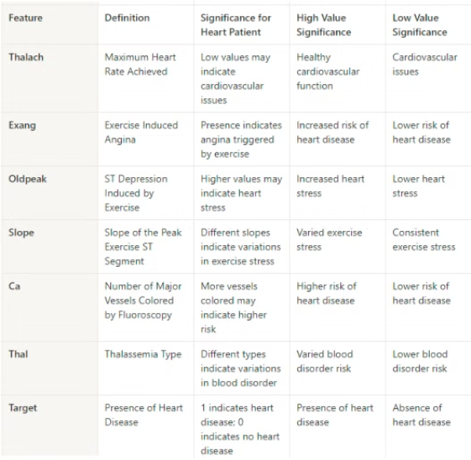
Feature Description

Slide 5
Main KPIs
1
Percentage of People Having Heart Disease:
2
Age Distribution including Gender:
3
Gender Distribution Based on Heart Disease
69% Are Male & 31 % are Females
51% Population having Heart diseases
55% Male & 45% Female are having Heart disease.
Remaining 49% don't have any heart diseases.
4
What is the Average Age
5
Average Cholestrol level
6
Average Blood Pressure
54
246 (mg/dl)
131.6 (mmHG)
7
Heart Rate
202 BPM

Slide 6
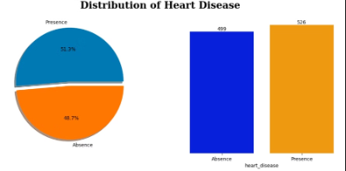
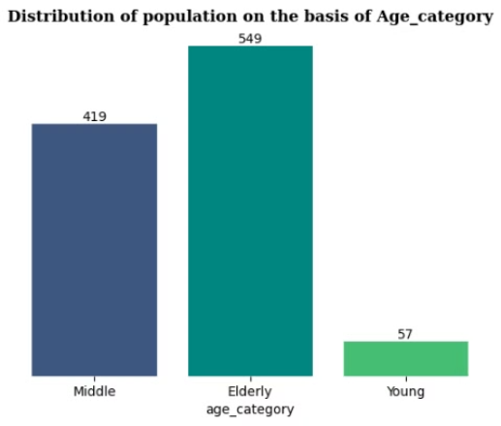
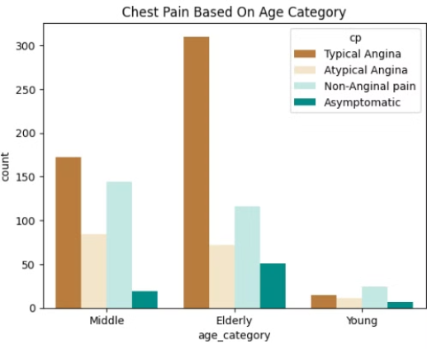
Python analysis:
Google Colab

Slide 7
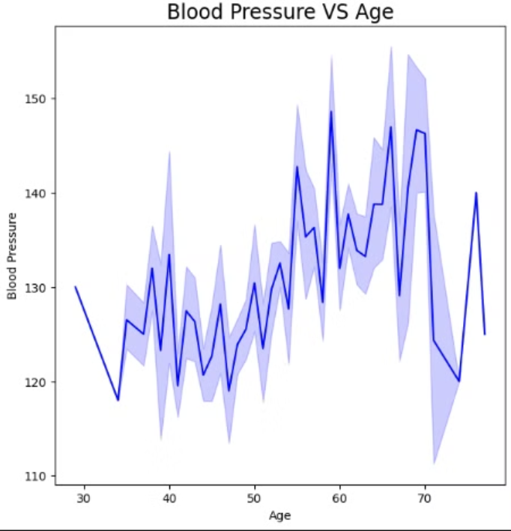
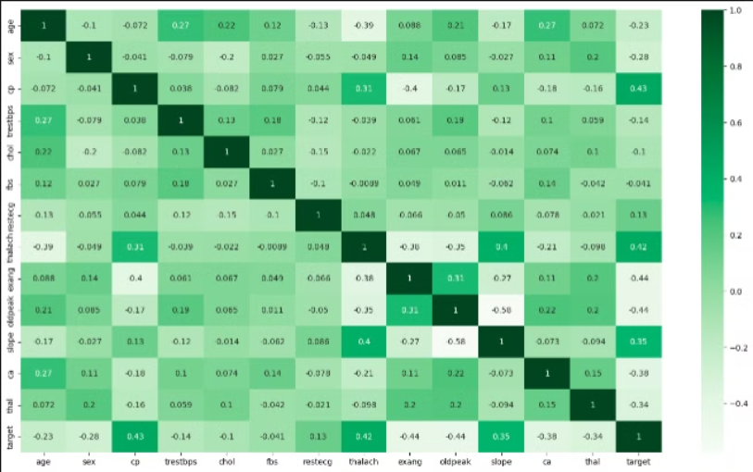
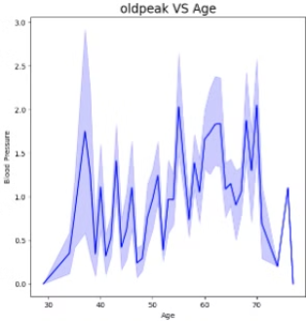
Python Analysis:

Slide 8
Inference from python
Dataset Overview: • Total observations in the dataset: 1025.
Target variable ('target') correlations: Strong positive correlation with chest pain ('cp') and maximum heart rate ('thalach').
Moderate positive correlations with slope of the peak exercise ST segment ('slope') and resting electrocardiographic results ('restecg').
Negative correlations with exercise-induced angina ('exang') and ST depression induced by exercise relative to rest ('oldpeak').
The strongest negative correlation with 'target' is observed for ‘exang'.
Chest Pain Types by Sex:
Breakdown of patients with different chest pain types (0, 1, 2, 3) based on gender:
Females : • Type 0: 133 patients • Type 1: 57 patients • Type 2: 109 patients • Type 3: 13 patients
Males : • Type 0: 364 patients • Type 1: 110 patients • Type 2: 175 patients • Type 3: 64 patients

Slide 9
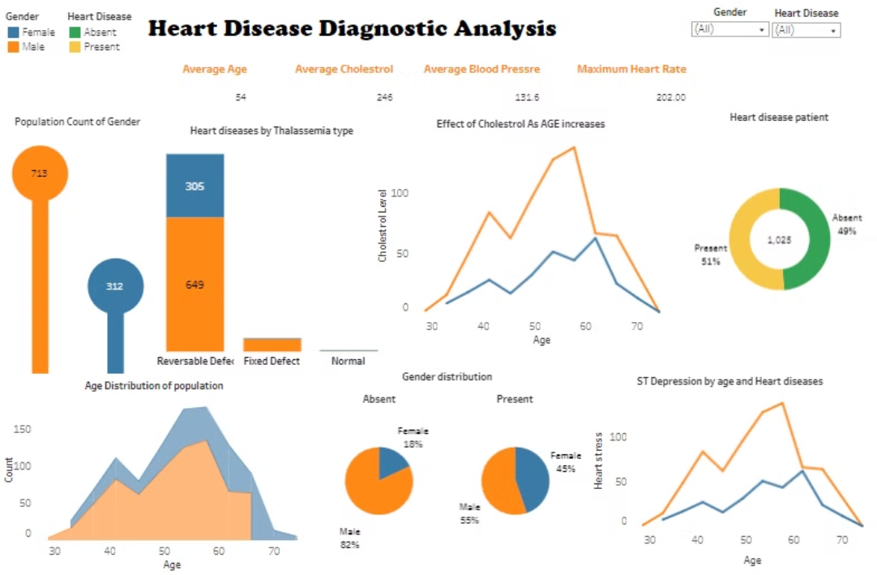
Dashboard 1:
Heart disease Diagnostic analysis

Slide 10
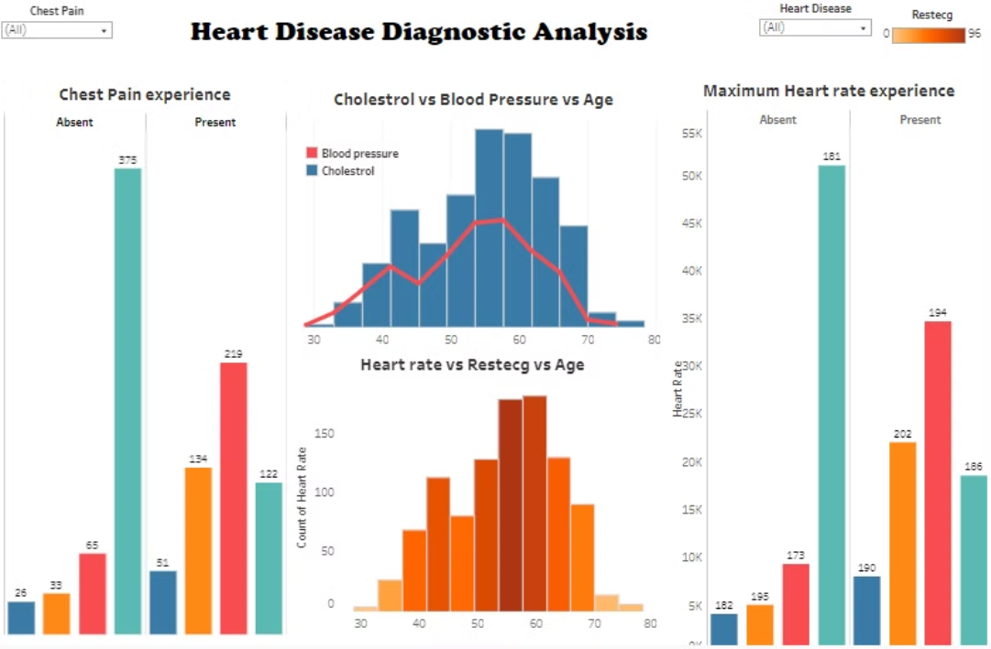
Dashboard 2
Heart disease Diagnostic analysis

Slide 11
Insights
1
Average Demographic
2
Heart Disease Analysis
3
Heart stress:
Average Age: 54
Males show higher susceptibility to heart disease thanFemales.
Male are having higher ST depression value of age between 50 -60
Average Maximum Heart Rate : 149
Average Resting Blood Pressure : 131
Cholesterol Analysis:
Heart rate vs restecg:
Average Cholesterol: 246
Highest cholesterol levels observed in the age group 50 - 65.
Population between 56-60 are having higher heart rate and Their Restng cardiographic result is also very high.
Average ST Depression Induced by Exercise (Old Peak): 1.5
Heart Rate and Blood Pressure Relation:
Heart rate and blood pressure are directly proportional, indicating a positive correlation between them.

Slide 12

Conclusion
This comprehensive analysis of heart disease has provided valuable and data-driven insights to support early detection, intervention, and management of this critical health challenge. By leveraging these insights, healthcare professionals can empower patients to take proactive steps towards maintaining a healthy heart and improving overall well-being.

